Slide 1


Smart Power for the Smart Home: Inverter Controls, Power Factor Corrections, and Peak Demand Reductions
G.P. Li, Keyue Smedley - UC Irvine
California Plug Load Research Center
Power Electronics Laboratory
Mark Modera, Nelson Dichter - UC Davis
Western Cooling Efficiency Center

Slide 2
Smart Load Management and Generation for Zero Net Energy Residences
Background:
Capacitance and inductance create and consume reactive power
Reactive power introduces difficulties maintaining a robust grid
Not possible to charge consumer for reactive power
Minimal consumer concern and resources allocated to correct and monitor the power factors
Project Goal:
Enable smart management of electric loads and generation for zero net energy residences while advancing three technological elements

Slide 3
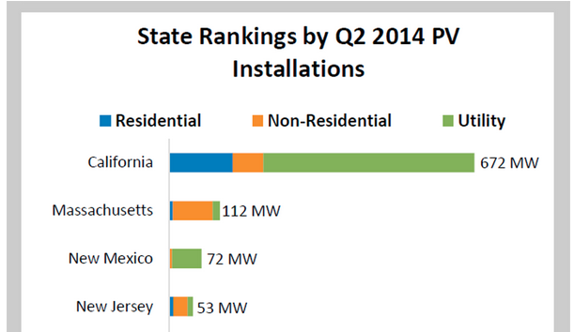
Benefits for Utilities and Users
Current:
~30% of national electricity usage is for residential areas
15.9GW of PV installed in US by Q2 2014
Can power 3.2 million homes
Challenges:
PV is an intermittent energy source
Various plug loads cause power factor to fluctuate
Solution:
Active power factor correction at PV inverter and home ADR

Slide 4
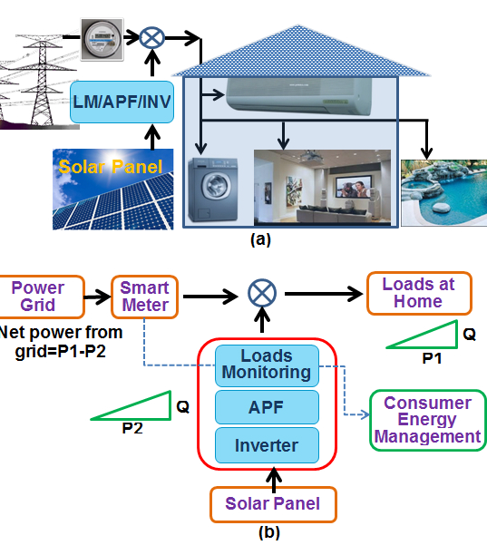
Main Technology Advancements
Inverter-integrated active power factor correction
Load signature analysis for wireless load monitoring and control
Integrated design and control of HVAC and storage for shifting peak demand (UCD)

Slide 5
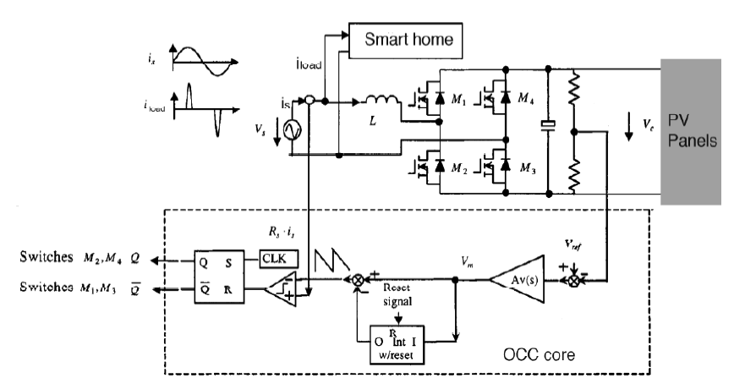
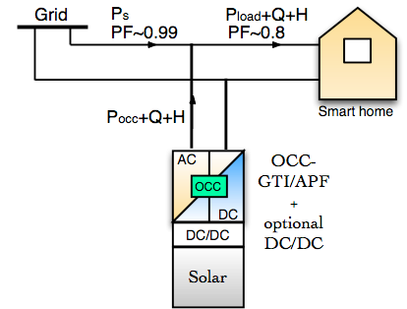
Inverter-integrated active power factor correction
Typical PV inverter provides active power only
Reactive power from the load will be passed to the grid
In net-zero situation, pure reactive will go to grid
Active power filter can cancel the reactive power

Slide 6
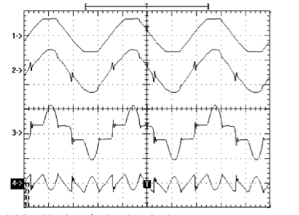
Active Power Filter Function
APF operation waveforms:
Grid voltage
Grid current
Load current
APF current
Remove reactive load and harmonic components
Realize power factor near 1
Reduce line losses
Increase line capacity
Protect sensitive loads

Slide 7
APF Objectives
This phase
Implement 1.5kW APF
Test and fine tune in the lab
Real circuit demonstration
APF can be used for retrofit
Next phase
Inverter with APF function built-in will be pursued
Field demonstration of inverter under net zero condition will show zero reactive and harmonics

Slide 8
Load signature analysis for wireless load monitoring-- Objectives
Background:
Little to no incentive for end users to shift off peak hour consumption
Consumer usage behavior information can be utilized to promote energy conservation
Objectives:
Provide utility end-use information for billing, efficiency program marketing, or demand response control
Provide load consumption feedback for users or for EMS

Slide 9
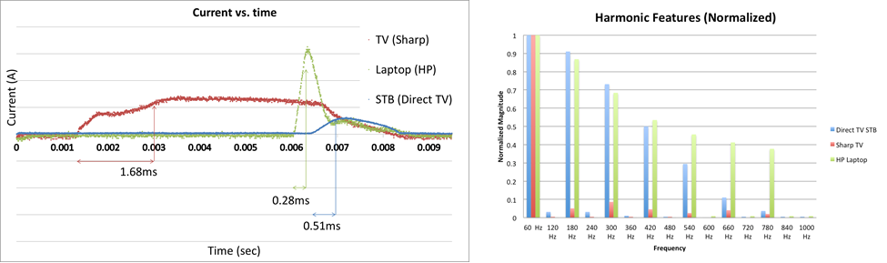
Load signature analysis for wireless load monitoring -- Approach
Technical Approach:
Use energy metering IC to measure real and reactive power to track and categorize appliances (macro load signature)
Use first 15-second waveform to further identify devices (micro load signature)
Use FFT to obtain harmonic content
Match devices from a database of load signatures and usage patterns of the consumers

Slide 10
Load signature analysis for wireless load monitoring – System Layout
Capturing →Analysis → Display
Signal comes in
Load Characteristics
Transient: PF, Power, Reactive Voltage and Current
Frequency: Harmonic Features
15sec
Transient
Load Characteristics matching
Server
Mobile Interface
Steady
States
FFT
Harmonic Features
System Layout:
Capture (ADE7763) Analyze (ARM & Linux) Data Storing (Server) Display (HTML Mobile Interface)

Slide 11
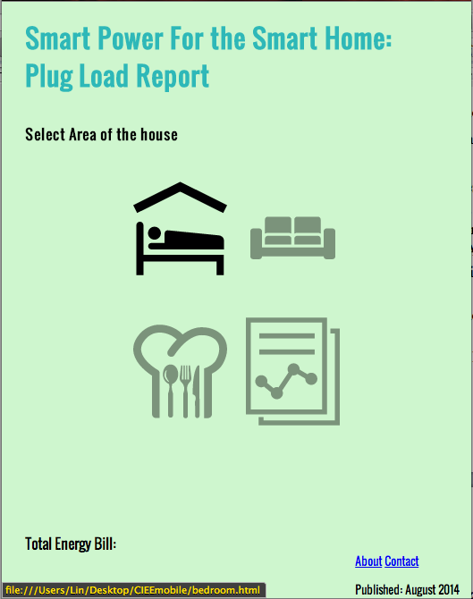
Load Signature Monitor and Report – Progress
Capture and Analysis Progress
Sectional Mobile Interface
Current and voltage probe measurements to build device library
Current Probe and TI2530 on SmartRF05 Board, with Raspberry Pi
ADE7763 to Arduino, to server

Slide 12
UC Davis Field Demonstration
UC Davis will conduct field demonstrations at the Honda Smart Home in Davis, California.
APFC device developed by UC Irvine will be installed and monitored to assess:
Energy flows and efficiencies for the device
Power factor correction effectiveness
Improvement to harmonics generated by the Smart Home
Load signature analysis device will be installed
Functionality and user interface will be demonstrated

Slide 13
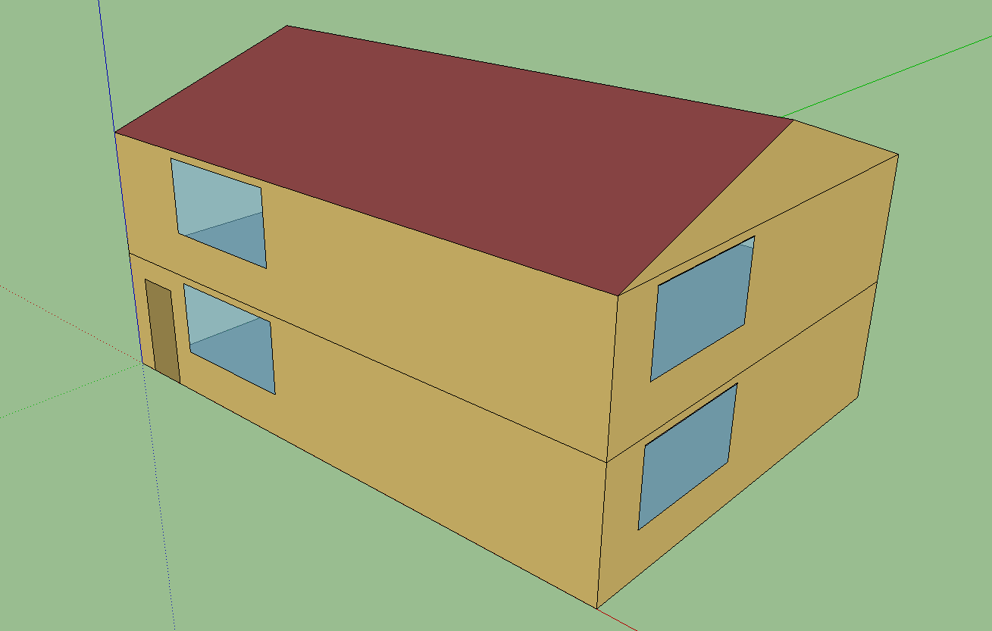
UC Davis Modeling
UC Davis will use EnergyPlus to model a ZNE home
Simulations will include:
Alternative mechanical system efficiencies
Alternative load shifting strategies
Different levels of generation
and storage
Differences in stochastic user behavior
Differences in end use load profiles, including electric vehicle use
UC Davis will use MATLAB model of APFC device provided by UC Irvine to post-process EnergyPlus results
Results will be used to determine impact of APFC device on the grid in various scenarios

